Slide 1
Symbiosis of science and production using advanced technologies

Slide 2
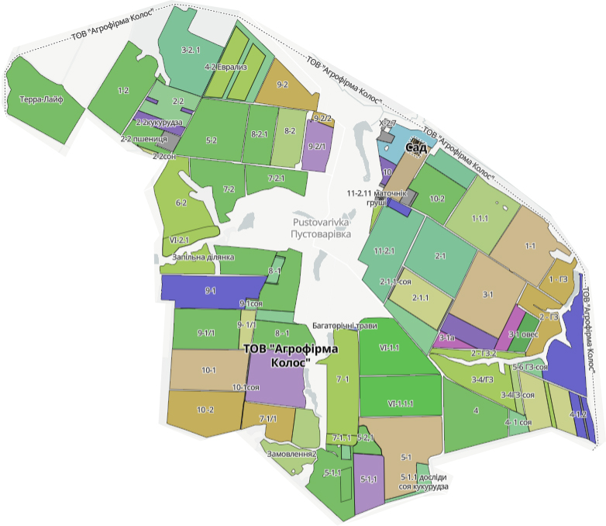
Limited liability company
«Agrofirma Kolos»
Is located on the territory of one settlement Pustovarivka
Average annual air temperature +9 °C The average annual rainfall is 460 mm Area - 4 thousand ha
The number of workers is more than 300
The annual turnover - 300 mln. UAH (8,1mln euros) Owner - Tsentilo Leonid, Doctor of Agricultural Sciences

Slide 3
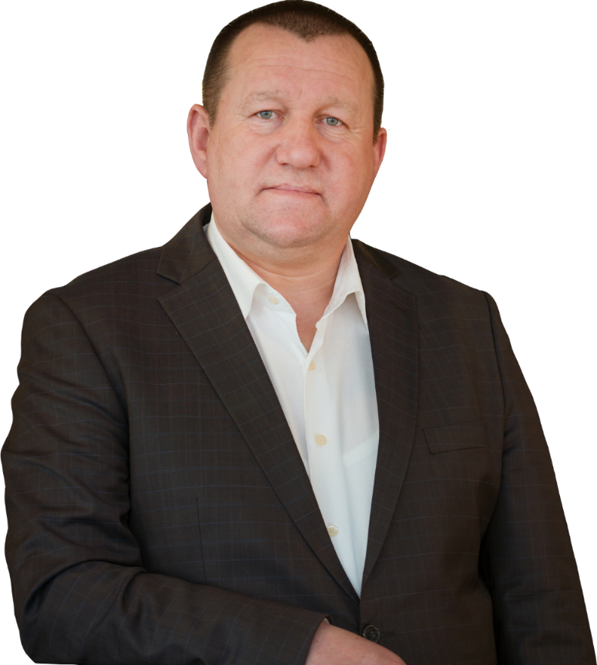
We intend to develop the agriculture with the help of the latest scientific approaches and the implementation of ambitious plans for the revival of the Ukrainian countryside. The development and formation of Ukraine through the acquisition of intellectual and scientific foundation will provide an opportunity to improve soil fertility management technologies, preserve bioclimatic potential, and implement an economically and energetically balanced model of a modern agricultural enterprise.
Leonid Tsentylo
Doctor of Agricultural Sciences
Laureate of the Cabinet of Ministers of Ukraine Award
Associate Professor of the Department of Agriculture and Herbology of the National University of Bioresources and Nature Management of Ukraine
Director of Agrofirma Kolos LLC

Slide 4
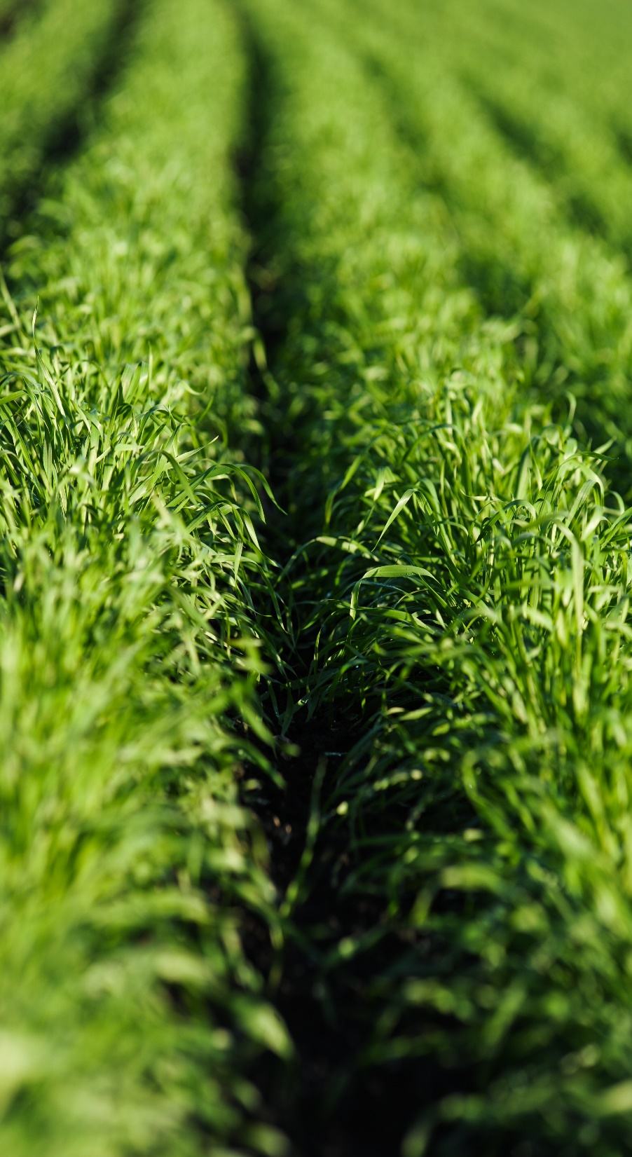
Advantages of an integrated multi-industry enterprise:
creation of new jobs
diversification of business profitability
creation of added value
reduction of dependence on foreign sales markets
balancing the seasonality of production
increase in marginal revenue

Slide 5
Areas of the enterprise activities
Biological agriculture
Composting technologies
Laboratory complex
Production of biologicals
Cleaning of water bodies
4,000 hectares of cultivation
Seed plant
Processing workshop
Dairy farming
Apiculture

Slide 6
CROP PRODUCTION
Seeds of grain crops
Commodity grain
Oil crops
Horticulture agroforestry melioration
Technical crops
Crop production AF KOLOS
Gross output:
Commodity grain: 10,000 tons - 60 million UAH
Seeds: 3,000 tons - 60 million UAH
Oil crops: 2,000 tons - 35 million UAH
Technical crops: 10,000 - 15 million UAH
Horticulture products: 1,000 tons - 10 million UAH

Slide 7
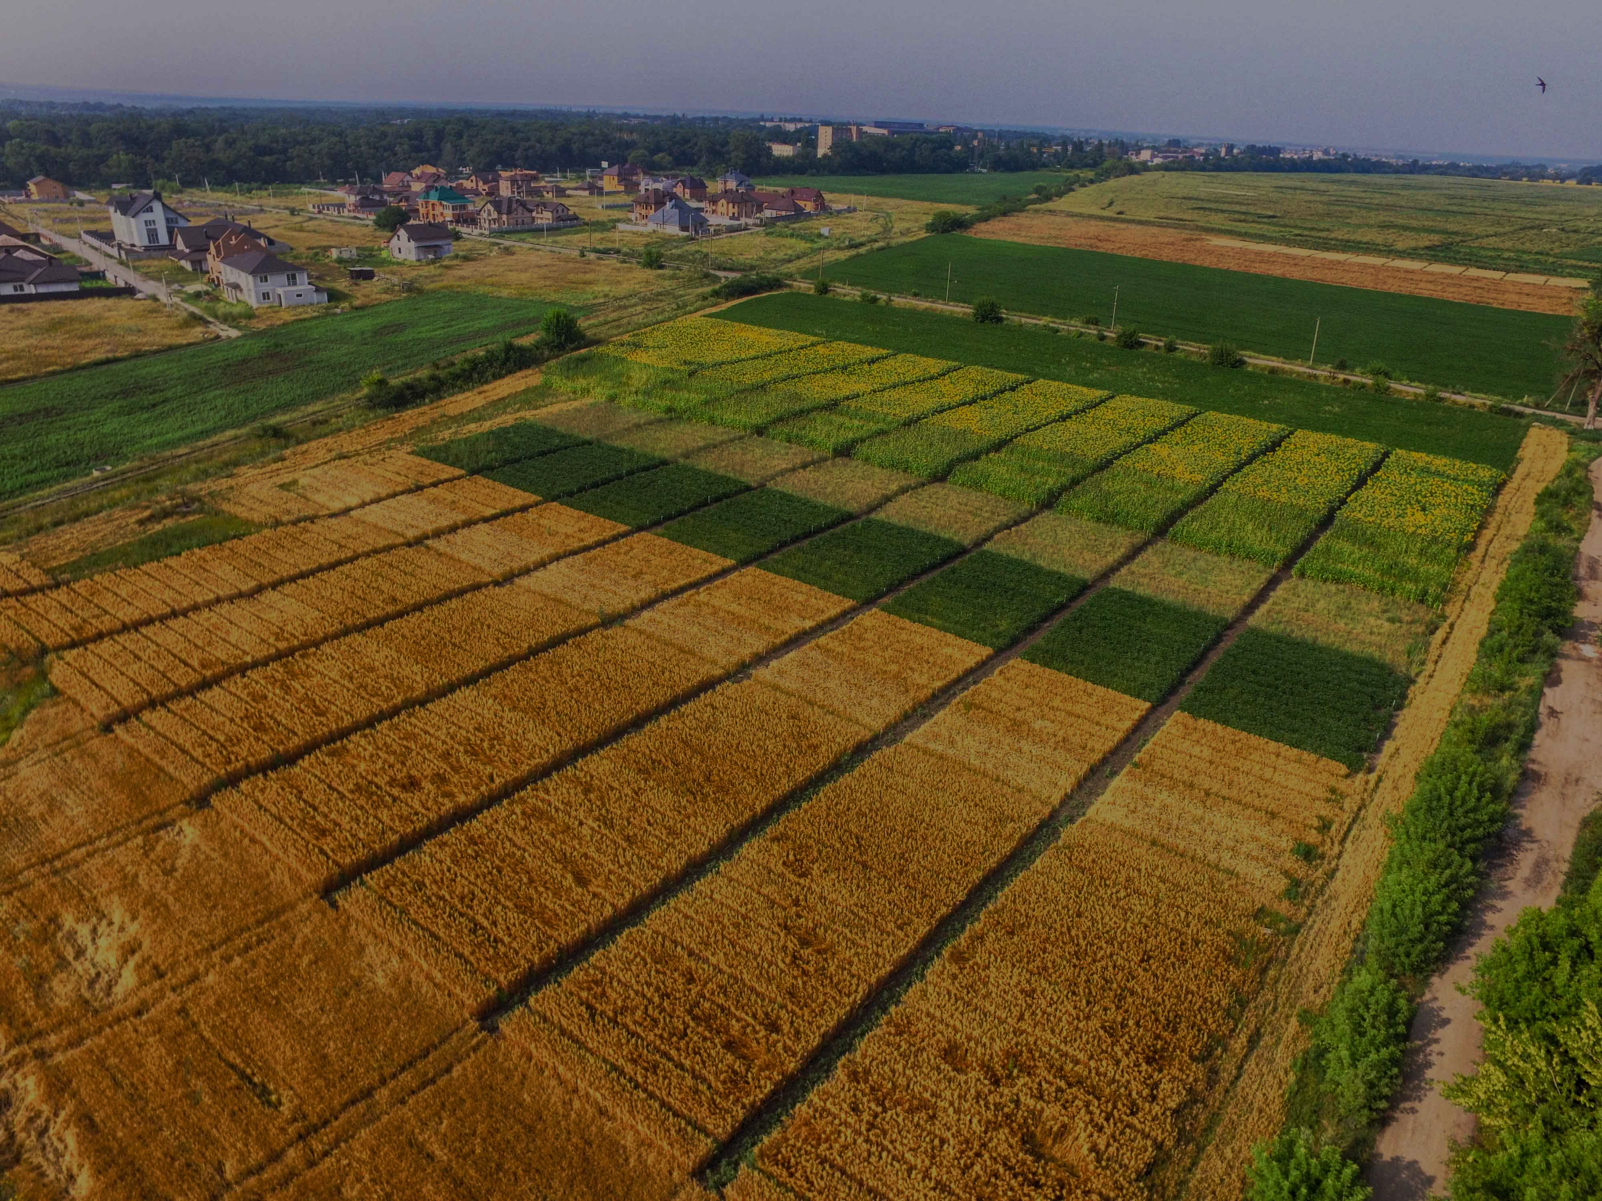
28 self-pollinating lines of corn
24 hybrids of corn
Entered into the state register of varieties and hybrids of Ukraine
Selection activities
AF KOLOS
9 varieties of winter wheat
6 varieties are under the state testing

Slide 8
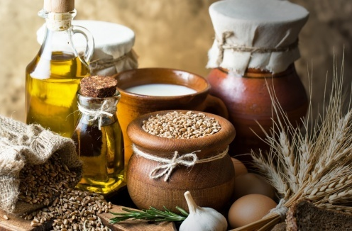
Processing of agricultural products is an integral part of a modern integrated enterprise
Processing industry AF KOLOS
Production of groceries
Production of finished products
Production of bakery products
Meat production

Slide 9
Modern management of agricultural production

Slide 10
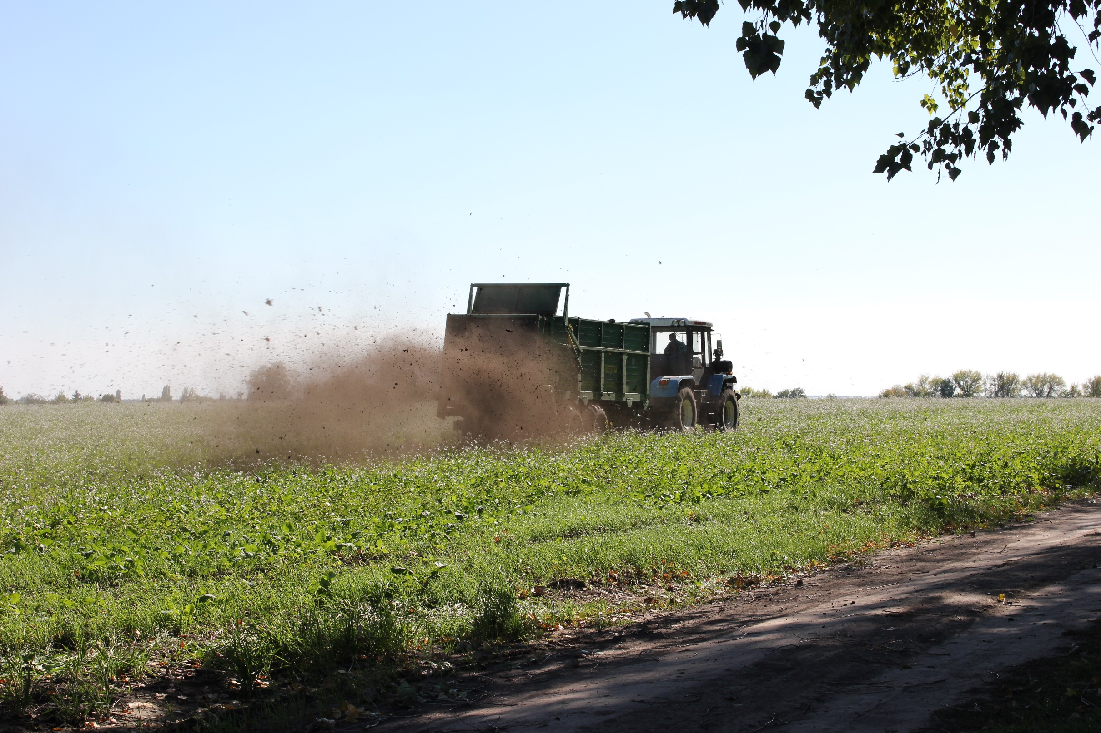
30,000 tons of organic waste is processed every year on the base of the enterprise
Organic fertilizers (composts) are the basis for restoring soil fertility
After10 years of using organic fertilizers, the level of humus increased by 1.4%
Organic agriculture

Slide 11
Animal husbandry AF KOLOS
Dairy farming
Meat farming
Sheep farming
Gross output:
Milk - 6000 tons/year
Meat - 200 tons/year
Fish - 100 tons/year
Honey - 5 tons/year
Horse farming
Fish farming
Apiculture

Slide 12
Key direction
Dairy commodity farm
cattle population – 1670 head
including cows – 696 head
constantly high productivity of 30 liters per day
high-quality milk with fat content of 3.7%, protein content of 3.3%
milk yield per cow is 9,850 liters per year

Slide 13
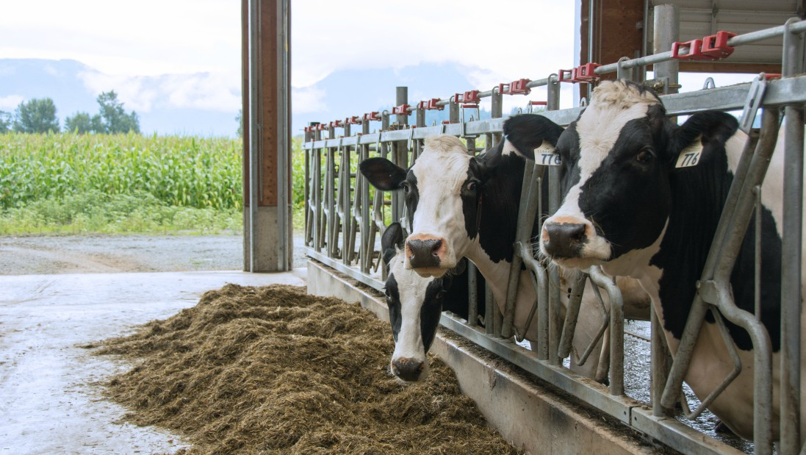
Genomic assessment by Zoetis
AF Kolos CLARIFIDE Dairy Report 2021
On-farm ID (Herd Management #) | Official ID | Breed Of Evaluation | Sire | Sire NAAB Code | Dam | Maternal Grandsire (MGS) | MGS NAAB Code | Birth Date | Sex | NM$ | NM$ % Rank | CM$ | FM$ | GM$ | TPI | Milk
87085 | HOUKR008016287085 | HO | HO840003132350030 | 551HO03441 | HOUKR008015142022 | HO840003128557377 | 029HO18202 | 2021/09/05 | F | 623 | 97 | 630 | 545 | 652 | 2457 | 516
87089 | HOUKR008016287089 | HO | HO840003132350030 | 551HO03441 | HOUKR008014424476 | N/A | N/A | 2021/09/05 | F | 530 | 93 | 537 | 469 | 490 | 2278 | 302
87072 | HOUKR008016287072 | HO | HO840003132350030 | 551HO03441 | HOUKR008015142068 | HO840003000540487 | 029HO16171 | 2021/08/31 | F | 319 | 74 | 324 | 293 | 327 | 2238 | 41
3484 | HOUKR008015783484 | HO | HOUSA000072596689 | 151HO03009 | HOUKR008013218218 | HOUSA000062253367 | 029HO13846 | 2021/07/10 | F | 281 | 69 | 291 | 199 | 311 | 2219 | -49
3500 | HOUKR008015783500 | HO | HOUSA000072596689 | 151HO03009 | HOUKR008013218280 | HO840003008160513 | 029HO16322 | 2021/07/27 | F | 267 | 67 | 280 | 160 | 318 | 2142 | -198
3472 | HOUKR008015783472 | HO | HOCAN000012111880 | 224HO04523 | HOUKR008013218363 | HOUSA000069990244 | 029HO16561 | 2021/06/28 | F | 225 | 61 | 235 | 172 | 216 | 2099 | -189
3489 | HOUKR008015783489 | HO | HOUSA000072596689 | 151HO03009 | HOUKR008012360500 | HOUSA000055642061 | 029HO14748 | 2021/07/13 | F | 213 | 59 | 218 | 161 | 215 | 2064 | 181
3493 | HOUKR008015783493 | HO | HO840003010353525 | 551HO03246 | HOUKR008013218226 | HOUSA000069314961 | 029HO16222 | 2021/07/19 | F | 211 | 59 | 215 | 176 | 227 | 2139 | 139
3451 | HOUKR008015783451 | HO | HO840003131910939 | 029HO18249 | HOUKR008013218341 | HOUSA000069314961 | 029HO16222 | 2021/06/06 | F | 200 | 57 | 190 | 288 | 184 | 2178 | 970

Slide 14
Enterprise statuses
in animal husbandry
Breeding plant for breeding Holstein cattle
Stable-reproducer for breeding horses of the Ukrainian riding breed
Breeding reproducer for breeding carps of the Ukrainian scaly breed
Breeding apiary for breeding bees of the Ukrainian steppe breed
Breeding reproducer for breeding variegated carps

Slide 15
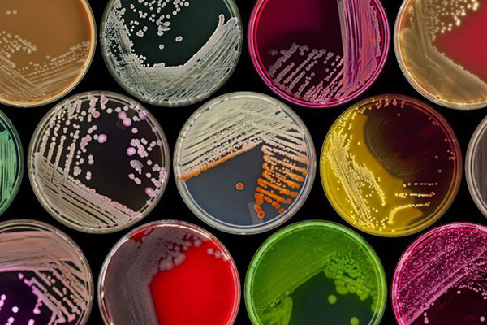
Department of selection and primary seed production
Microbiological department
Department for determination of seeds sowing qualities
RESEARCH ACTIVITIES OF AF KOLOS
Department of agrochemical research
Analytical department
Research activities AF KOLOS
Modern agrochemical and microbiological laboratory
15 drugs of biological origin are registered
20 strains of microorganisms are deposited
7 patents for utility models are received

Slide 16
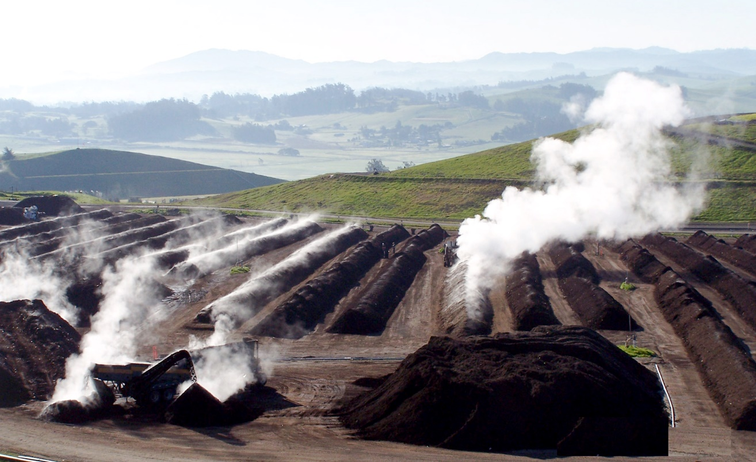
Production of biologicals and multicomponent microfertilizers
Technologies for processing organic waste into technological fertilizer - composts
Water purification technologies using microbiological products
Odor control of organic waste from animal husbandry and poultry farming
Elaborated
technologies
1,000,000 tons of organic waste (liquid fractions and digestates) are annually processed in Ukraine using our composting technologies based on our own microbiological products

Slide 17
Educational scientific and innovative center of modern agricultural technologies
On the base of LLC "AGROFIRMA "KOLOS" in Pustovarivka settlement
Professional formation of higher education students
Elaboration of individual target trainings for students
Elaboration of innovative technological documentation projects
Advanced training of enterprise specialists

Slide 18
Joint scientific activities
As part of cooperation with leading scientific institutes and private companies, we regularly hold educational events, seminars and conferences on various issues of agronomy, composting (processing of organic waste), animal husbandry, and horticulture in order to develop agribusiness in Ukraine
Every year, about 100 students of higher educational institutions perform educational and industrial practice

Slide 19
Thank you for your attention!
Peremohy square 18А, Pustovarivka, Bila Tserkva region, Kyivska oblast, 09051, Ukraine.
E-mail: agrokolos@i.ua www.agrokolos.com.ua
+380987815126 +380992246994

